Slide 1
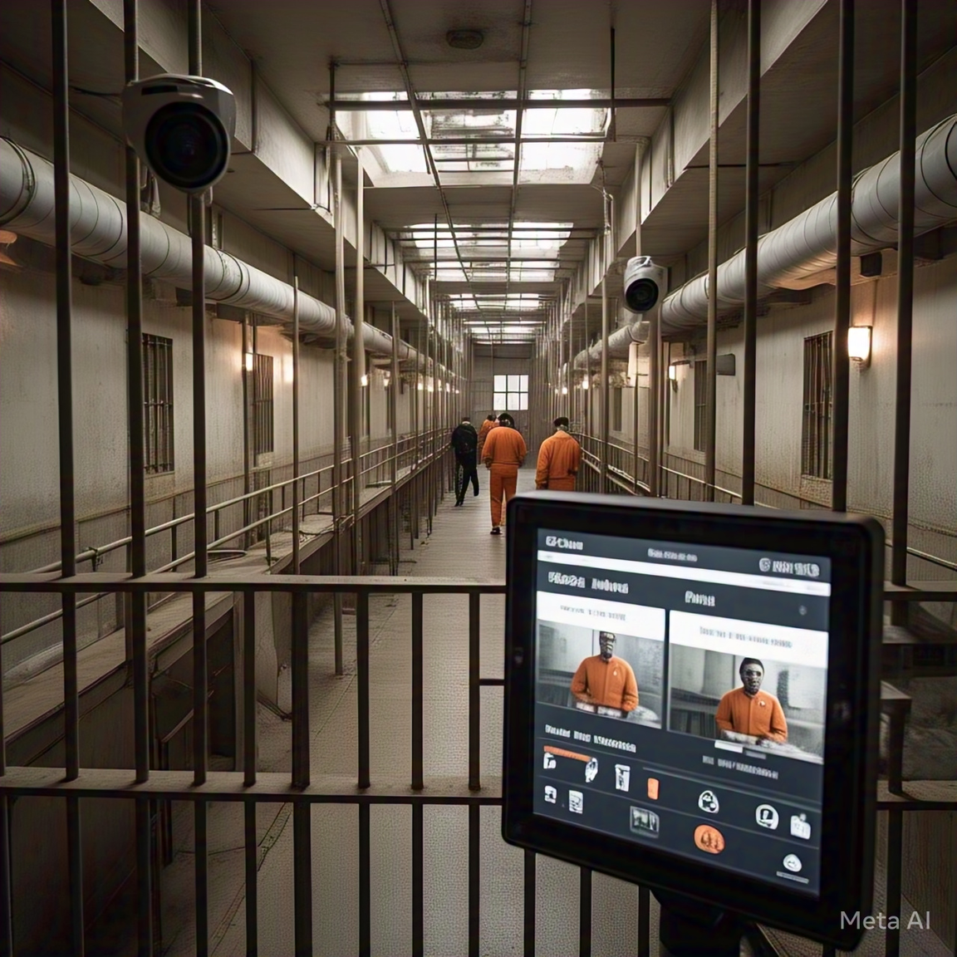
PRISONSECURE: A SMART SURVEILLANCE
SYSTEM FOR PRISONS USING DEEP
LEARNING
International Conference On Intelligent Systems And Digital Transformation (ICISD’25)

Slide 2
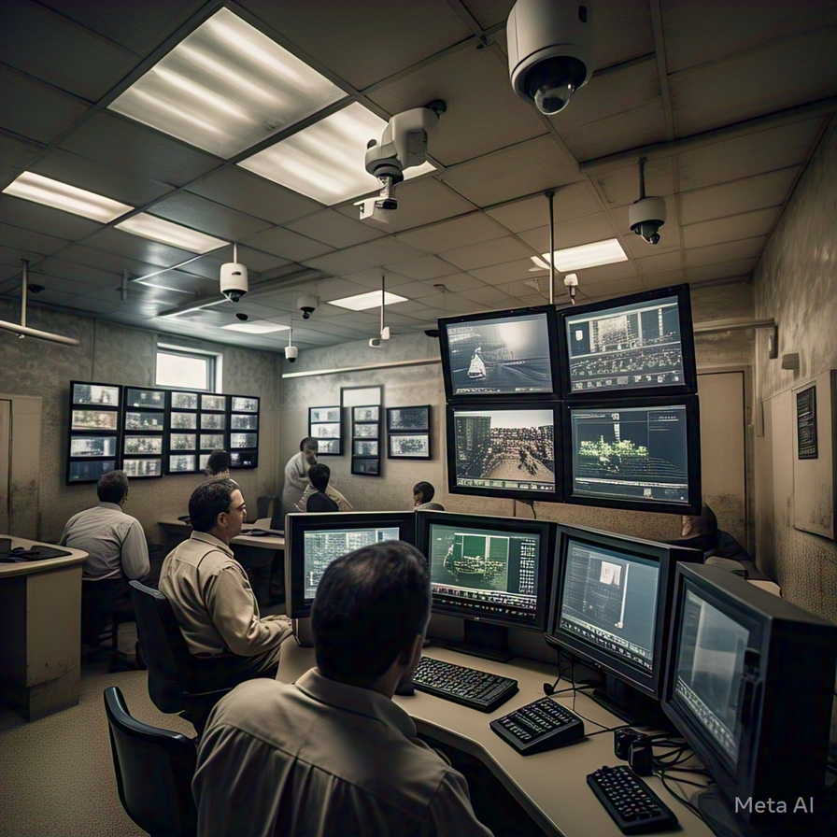
INTRODUCTION
PRISONSECURE is a smart surveillance system designed to enhance prison security using deep learning techniques.
Utilizes YOLOv11 for real-time detection of weapons like guns and knives, even in challenging conditions.
Employs a ResNet-based face detector, FaceNet embeddings, and an SVM classifier for reliable prisoner identification.
Includes an audio alert system to trigger immediate response to potential threats.

Slide 3
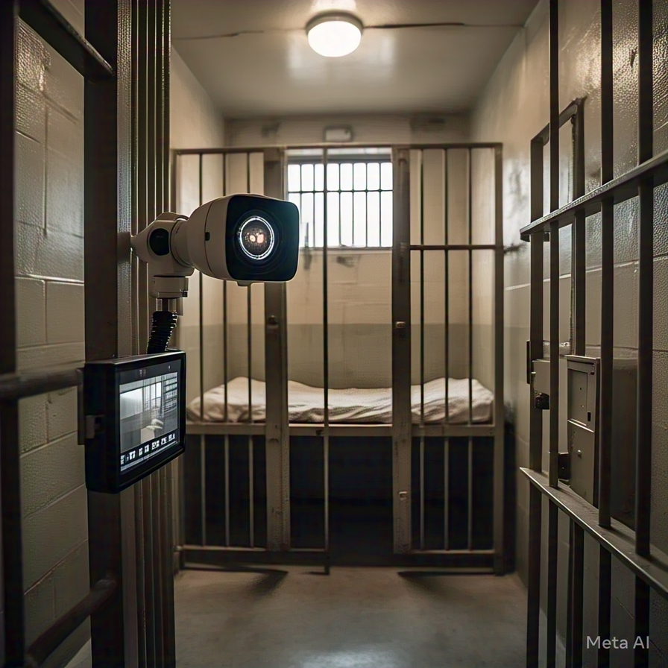
MOTIVATION
Manual surveillance is time-consuming and often prone to errors.
Weapons still enter prisons despite strict security checks.
Faster response is crucial for prison safety.
Deep learning enables real-time, accurate threat detection.

Slide 4
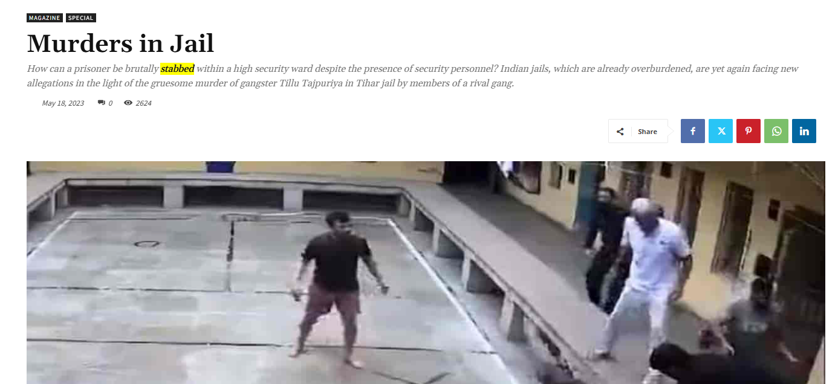
Despite extensive CCTV coverage and security measures at South Asia’s largest prison, four inmates used knives to kill a top gangster inside a high-security cell. The incident, now under investigation by prison authorities, Delhi Police, and the NHRC, raises serious concerns about lapses in surveillance and response. Jail officials on duty at the time have been issued show cause notices and asked to explain delays in their intervention.

Slide 5
LITERATURE SURVEY
Authors | Paper Title | Limitations
Qi et al. [1] | Real-Time Gun Detection Using Smart IP Cameras and Cloud-Based Deep Learning | No mention of face recognition; edge-cloud dependency may introduce latency or security concerns
Thakur et al. [2] | YOLOv8-Based Real-Time Weapon Detection for Public Surveillance | Focused only on public spaces (e.g., schools, airports); limited to YOLOv8 without hybrid enhancements
Chatterjee et al. [3] | Dual-Cue Firearm Detection with Ensemble of Faster R-CNN and EfficientDet | Computationally intensive due to ensemble methods; real-time performance under stress not detailed
Serna et al. [4] | AI-Powered Surveillance for Train Platform Safety | Limited to specific anomaly types; does not address facial recognition or prison-specific contexts

Slide 6
LITERATURE SURVEY
Authors | Paper Title | Limitations
Qi et al. [5] | Deep Face Recognition Using MTCNN and FaceNet with Triplet Loss | Only tested on LFW dataset; lacks integration with surveillance systems or low-light robustness
E et al. [6] | Integrated CCTV-Based Facial Recognition Using MTCNN, FaceNet, and K-NN | KNN may struggle with large-scale datasets; general face detection performance in crowds not analyzed
Yadav et al. [7] | WeaponVision AI: Modified YOLOv7 for Real-Time Gun Detection | Does not include facial recognition; YOLOv7 may be outdated compared to newer versions
Clunie et al. [8] | YOLOv5-Based Gun Detection Prototype for Surveillance Footage | Moderate mAP (0.645); lacks face recognition and limited in low-light adaptability

Slide 7
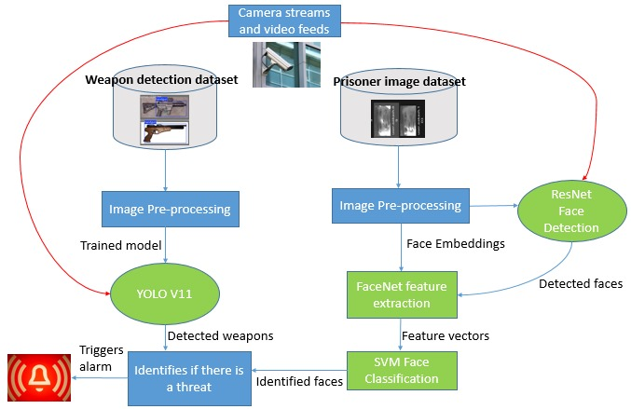
METHODOLOGY

Slide 8
DATA COLLECTION MODULE
For weapon detection, a balanced dataset of 3,735 handgun, 3,930 knife, and 4,897 non-weapon images was compiled from public datasets, surveillance footage, and manual sources, covering varied lighting and angles. A 70-20-10 split ensures proper training, validation, and testing.
For facial recognition, face data was collected in real-time via webcam. Detected faces were cropped, resized (200x200), and converted to grayscale for efficiency. Images were saved using a structured format: user.<label>.<image id>.jpg.
a) Sample images from weapon detection dataset
b) Sample images from facial recognition dataset

Slide 9
HARD NEGATIVE MINING
Hard Negative Mining is a training strategy used in object detection to focus the model on the most difficult negative (non-object) examples—those it often mistakes for actual objects (e.g., a metal spoon mistaken for a knife).
Problem | Without HNM | With HNM
False Positives | High (non-weapons misclassified) | Reduced
Model Robustness | Poor in real environments | Stronger generalization
Weapon Detection Accuracy | Lower (especially knives) | Improved
Real-Time Performance | Lag due to incorrect alerts | Faster & precise

Slide 10
WEAPON DETECTION MODULE
The system uses a YOLOv11-based model to detect guns and knives in real time from surveillance footage.
YOLOv11(You Only Look Once version 11) is an advanced real-time object detection model known for its high speed and accuracy, building upon previous YOLO versions with improvements in feature extraction and prediction refinement.
Preprocessing (contrast enhancement, noise reduction) and hard negative mining help reduce false positives.
Yolov11 architecture

Slide 11
WEAPON DETECTION MODULE
YOLOv11 was chosen for its high performance, achieving a mAP@0.5 of 0.9578, along with excellent precision and recall scores.
Hyperparameter Optimization:
Hyperparameter | Value | Description
imgsz | 736 × 736 | Balances model accuracy and GPU memory consumption.
batch | 16 | Optimized for RTX 3050 (8GB) GPU efficiency.
epochs | 100 | Total training cycles; sufficient to ensure convergence.
patience | 10 | Early stopping to avoid overfitting during training.
optimizer | AdamW | Adaptive optimizer for stable and efficient learning.
lr0 | 0.0001 | Initial learning rate for AdamW optimizer.
momentum | 0.95 | Helps accelerate SGD in the right direction and dampens oscillations.
cos lr | True | Cosine scheduler for smooth learning rate decay.
label smoothing | 0.05 | Reduces model overconfidence by softening hard labels.
conf | 0.2 | Confidence threshold for detection.
iou | 0.6 | IoU threshold for NMS (non-max suppression) during inference.
augment | True | Enables standard data augmentation.
mosaic | 0.5 | Combines 4 training images into one for object diversity.
mixup | 0.05 | Merges images and labels to improve generalization.
auto augment | randaugment | Applies a series of randomized augmentations for robustness.
erasing | 0.4 | Random erasing helps the model handle occlusion.
cache | disk | Stores preprocessed data on disk for faster loading.
amp | True | Enables faster training and reduced memory use.
save period | 5 | Model checkpoints saved every 5 epochs.
workers | 2 | Number of data loading workers. Optimized for system I/O.
device | GPU (RTX 3050) | Specifies GPU usage for training acceleration.

Slide 12
FACIAL RECOGNITION MODULE
A ResNet-based detector locates faces in real time.ResNet is a deep neural network that uses skip connections to train very deep models effectively without performance loss.
FaceNet then extracts 128-dimensional embeddings.FaceNet is a deep learning model developed by Google that maps facial images to a compact 128-dimensional vector, called an embedding, where similar faces are close together in the vector space—making it ideal for tasks like face recognition, verification, and clustering.
Then it is classified using an SVM with RBF kernel.
SVM (Support Vector Machine) is a supervised machine learning algorithm used for classification and regression tasks. It works by finding the best boundary (hyperplane) that separates different classes of data with the maximum margin.
The RBF (Radial Basis Function) kernel is a popular kernel used in Support Vector Machines (SVMs) to handle non-linear data by mapping it into a higher-dimensional space where it becomes linearly separable.

Slide 13
FACIAL RECOGNITION MODULE
Hyperparameter Optimization :
Hyperparameter | Value | Description
Hyperparameter | Value | Description
Learning Rate | Not applicable | SVM does not use learning rates, as it is not gradientbased.
Batch Size | 32 | Number of images processed at a time during embedding generation.
Kernel | RBF | sed for the SVM classifier to handle non-linear separations.
Test Size (Train/Test Split) | 20% | Ratio of test samples to the total dataset during model evaluation.
Embedding Size | 128 | The size of feature vectors generated by FaceNet.
Confidence Threshold | 70% | Minimum confidence required for recognizing a face in the detection pipeline.

Slide 14
ALERT DETECTION MODULE
provides real-time notifications when weapons like guns or knives are detected.
It uses calibrated thresholds to reduce false alarms and supports clear MP3 alerts via pydub and simpleaudio.
Multithreading ensures smooth, delay-free operation, handling multiple threats simultaneously with synchronized audio-visual cues.

Slide 15
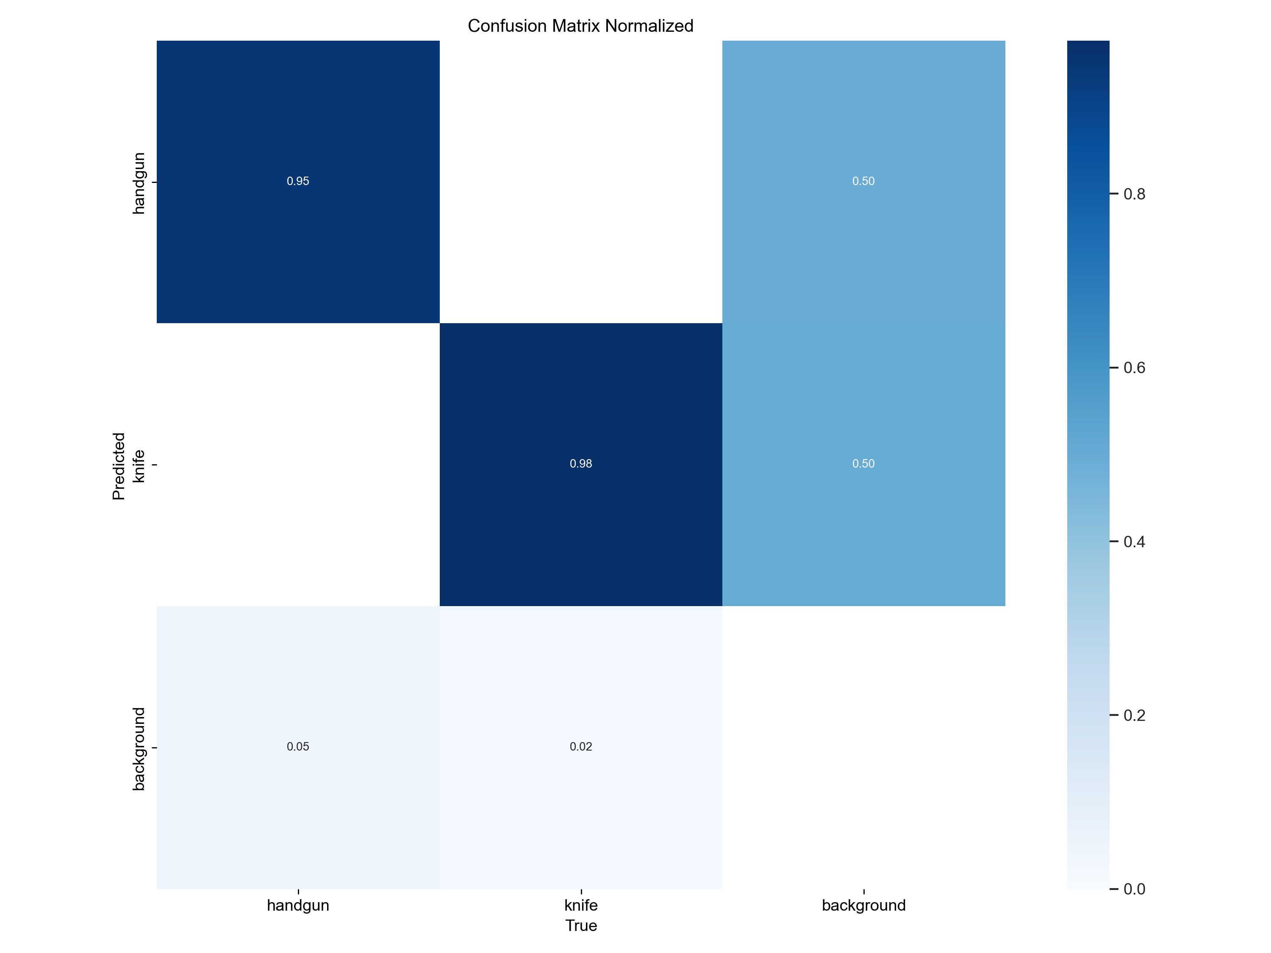
RESULTS & DISCUSSION
Weapon Detection Performance
YOLOv11 outperformed all the other yolo models with 93.15% precision, 93.62% recall, and the highest mAP of 95.79%, making it ideal for high-risk environments. mAP@0.5 of 95.77 % and mAP@0.5:0.95 of 81.45 % demonstrate strong localization even under strict IoU thresholds.
Confusion matrix shows 95 % handgun and 98 % knife accuracy; background occasionally misclassified—highlighting need for hard‑negative mining.
Model | Precision | Recall | mAP@0.5 | mAP@0.5:0.95 | F1-based Accuracy
YOLOv5 [1] | 0.8940 | 0.7010 | 0.8050 | N/A | N/A
YOLOv7 [9] | 0.9100 | N/A | 0.9173 | N/A | 0.9100
YOLOv8 | 0.9404 | 0.9043 | 0.9509 | 0.8031 | 0.9220
YOLOv11 | 0.9315 | 0.9362 | 0.9579 | 0.8182 | 0.9339

Slide 16
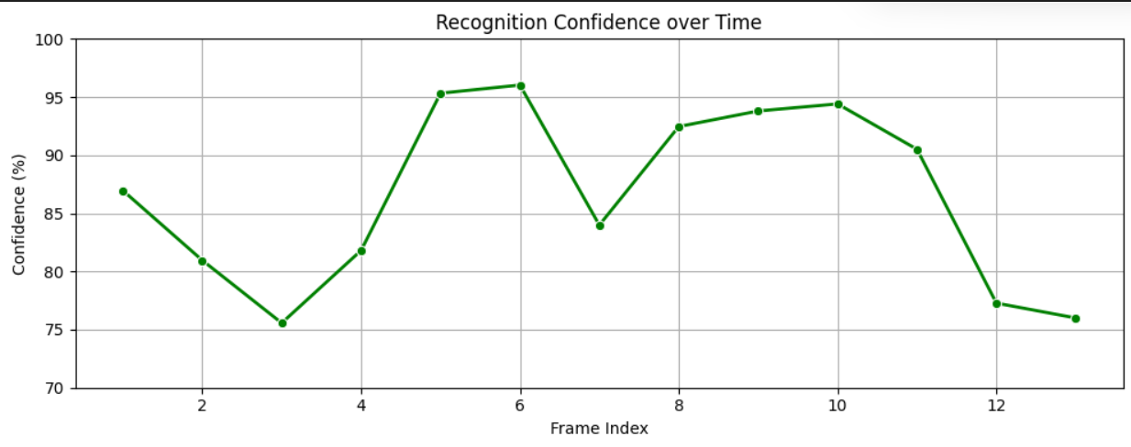
RESULTS & DISCUSSION
Face Recognition Robustness
Recognition confidence consistently ranged 75 %–96 % across varied lighting, poses, and backgrounds.
Frame‑by‑frame consistency (56–85 ms per frame) supports near‑real‑time performance.
ResNet + FaceNet + SVM pipeline-maintained identity integrity despite minor motion and occlusion.

Slide 17

RESULTS & DISCUSSION
Real Time Implementation

Slide 18
CONCLUSION
PRISONSECURE is an advanced surveillance system for high-security environments, offering real-time weapon detection and facial recognition using deep learning.
It employs YOLOv11 with a mAP@0.5 of 95.79% for accurate detection of weapons like guns and knives.
The facial recognition module, combining ResNet, FaceNet, and an SVM classifier, maintains over 90% confidence even in low light or occlusion.
Its alert system responds swiftly, averaging just 0.18 seconds.

Slide 19
FUTURE SCOPE
Expanding the model to detect suspicious behaviors.
Incorporating action recognition using pose estimation or temporal modeling for deeper scene understanding.
Deploying optimized lightweight versions for edge devices like CCTV nodes.
Making a Chatbot that logs in alert incident and give insights on it
Implementing privacy-preserving features such as on-device processing and encryption.
Implementing Concealed weapon detection based on thermal images
Enhancing the system via continuous learning from real-world feedback to improve adaptability and reduce false alarms over time.

Slide 20
REFERENCES
[1] Thakur, A., Shrivastav, A., Sharma, R., Kumar, T., Puri, K. (2024). RealTime Weapon Detection Using YOLOv8 for Enhanced Safety. arXiv preprint arXiv:2410.19862
[2] Qi, D., Tan, W., Liu, Z., Yao, Q., Liu, J. (2021, October). A dataset and system for real time gun detection in surveillance video using deep learning. In 2021 IEEE international conference on systems, man, and cybernetics (SMC) (pp. 667-672). IEEE.
[3] Jayadharshini, P., Vasuki, C., Santhiya, S., Sathiyaseelan, S., Chinnappan, D. P., Srinesh, S. (2024, December). A Comparative Analysis of Diverse Deep Learning Techniques for Facial Emotion Recognition. In 2024 IEEE 4th International Conference on ICT in Busi ness Industry Government (ICTBIG) (pp. 1-6). IEEE.
[4] Chatterjee, R., Chatterjee, A., Pradhan, M. R., Acharya, B., Choudhury, T. (2023). A deep learning-based efficient firearms monitoring technique for building secure smart cities. IEEE access, 11, 37515-37524.
[5] Serna, A. A., Yu, X., Saniie, J. (2024, May). AI-Based Security Surveillance and Hazard Detection for Train Platform Safety. In 2024 IEEE International Conference on Electro Information Technology (eIT) (pp. 185-190). IEEE
[6] Pudyel, M., Atay, M. (2023, April). An exploratory study of masked face recognition with machine learning algorithms. In SoutheastCon 2023 (pp. 877-882). IEEE
[7] Dhanshika, N., Lahamage, D., Anupam, T., Sawant, R. (2024, March). CCTV Integrated Attendance Monitoring System Using Face Recognition. In 2024 3rd International Con ference for Innovation in Technology (INOCON) (pp. 1-7). IEEE.
[8] Yeddula, N., Reddy, B. E. (2022, December). Effective deep learning technique for weapon detection in CCTV Footage. In 2022 IEEE 2nd International Conference on Mo bile Networks and Wireless Communications (ICMNWC) (pp. 1-6). IEEE
[9] Bhattarai, A., Dhakal, S., Timalsina, A. K. (2022, March). Enhancing Automatic At tendance System using Face Recognition. In 2022 IEEE Global Engineering Education Conference (EDUCON) (pp. 1048-1054). IEEE
[10] Celine, J. (2019, November). Face recognition in CCTV systems. In 2019 International conference on smart systems and inventive technology (ICSSIT) (pp. 111-116). IEEE.

